Slide 1
EECS 452
Lab 2: Object Tracking

Slide 2
This Week in EECS 452
Submit Pre-Lab 2
Due this Friday (9/18, 11:59pm):
  Lab 1 Report
Start this Week:
  Pre-Lab 3 (due 9/23, 3:30pm)
  HW 1 (due 9/21, 11:59pm)
  Lab 2 (report due 9/25, 11:59pm)

Slide 3
Lab 2 Overview
Goal: Use color thresholding on real-time video to track an orange ping-pong ball
Sections:
Pre-Lab: Understand RGB/HSV values
Video Capture
Color (Hue) Thresholding
Timing & Reducing Latency
Ping-Pong Ball Localization

Slide 4
General Tips
Download the entire LABS folder off canvas onto your RPi this lab. You’ll need a lot more downloads throughout the rest of the labs, it’s easier (and more organized) to just download it all now
the lab is not written very well for each section. The code has each TO-DO labelled. Ctrl+F the code to find each section (3.1, 3.2, etc.) and implement your code based on that.

Slide 5
1 - Pre-Lab
Refer to Matlab’s page on Color Spaces & Conversions
  “RGB” - Red/Green/Blue color space
  “HSV” - Hue/Saturation/Value color space
To make histograms, use imhist function in Matlab

Slide 6
2 - Video Capture
In general, if camera is “not working” (refusing to connect, display image, etc.)
  (1) Unplug & plug the camera back in
  (2) Restart the RPi
  (3) After three attempts, ask IA/GSI for help (may be hardware issue)
Hints:
  Circular buffer: fixed-size queue of data, with first-in-first-out (FIFO) data replacement
  OpenCV uses BGR color space
  Use ord function to get Unicode for particular keypress (e.g., ord(“c”))

Slide 7
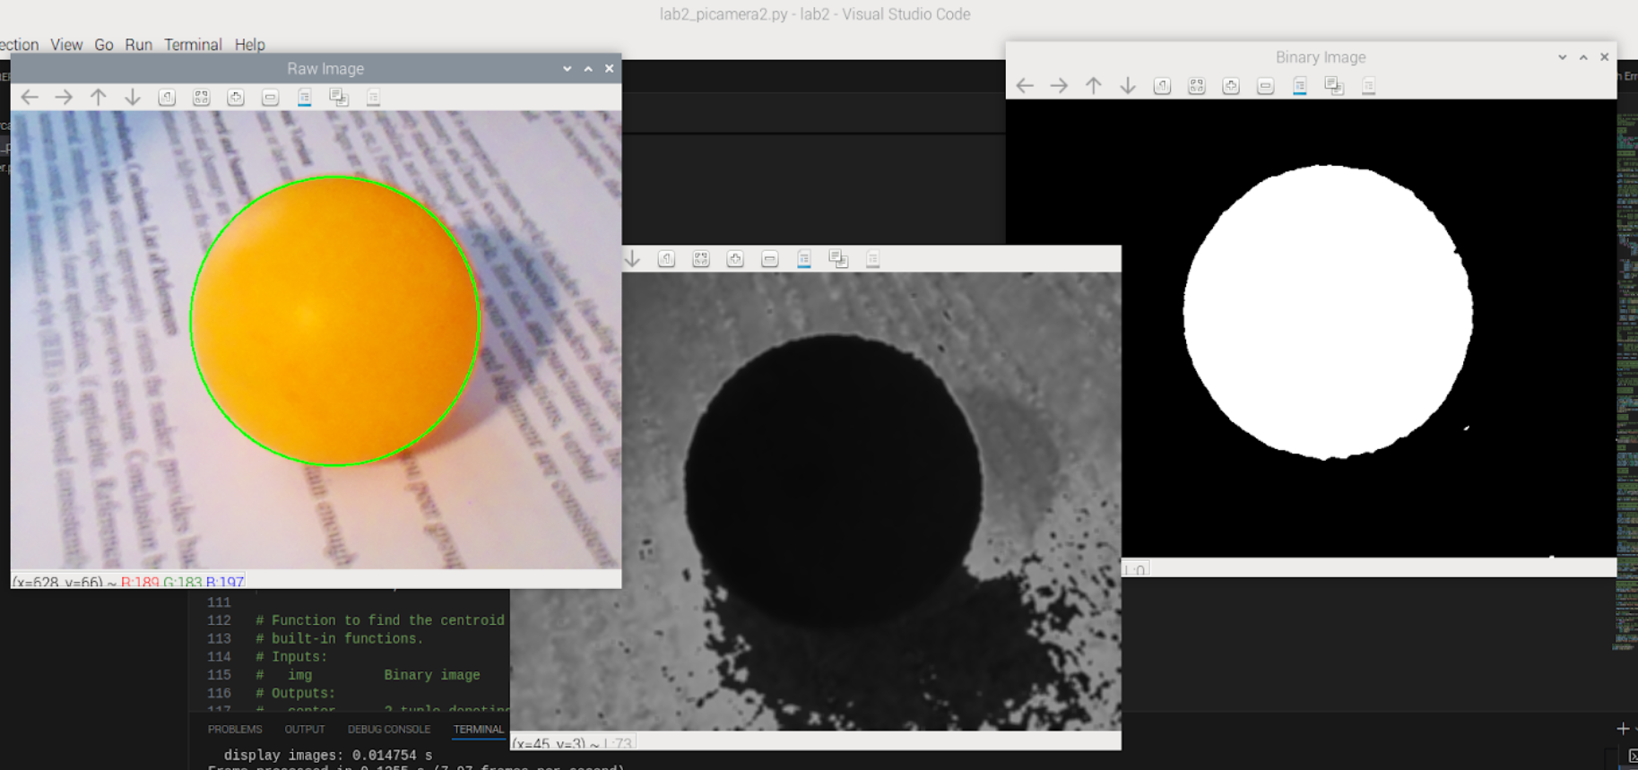
3 - Color Thresholding
Helpful tool to find H-value: RGB to HSV converter
Hints:
  In color_subtract, pixel default values are 8-bit integers — this will cause overflow in your calculations! Use Numpy astype (or dtype parameter in asarray) to upcast
  In our binary image, we want the ping-pong ball to appear as white
  Access trackbar value with getTrackbarPos function
  You don’t need to use the ret value from OpenCV’s
  threshold function!

Slide 8
4 - Timing
Use Timer class provided in code outline

Slide 9
5 - Ball Localization
Method 1: Arithmetic/Heuristic
  Assumption: all white pixels in the binary image belong to the ball
  Therefore, the centroid of all white pixels will be the center of the ball
    I.e., arithmetic mean of the x and y values of all pixels
  Total number of white pixels is area of ball (recall: A = πr²)
Method 2: Index Image
  Linear algebra implementation of arithmetic approach (less intuitive)
  Using Numpy functions
  Hint: we can think of x_idx and y_idx as masks for the x and y components of white pixels

